Slide 1
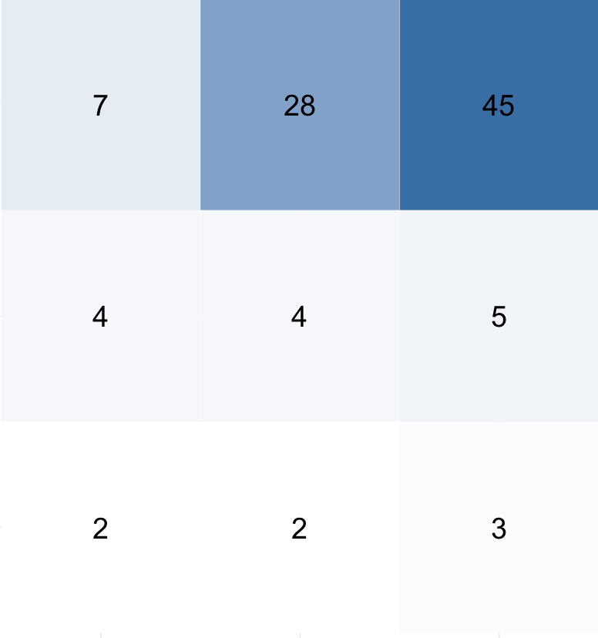
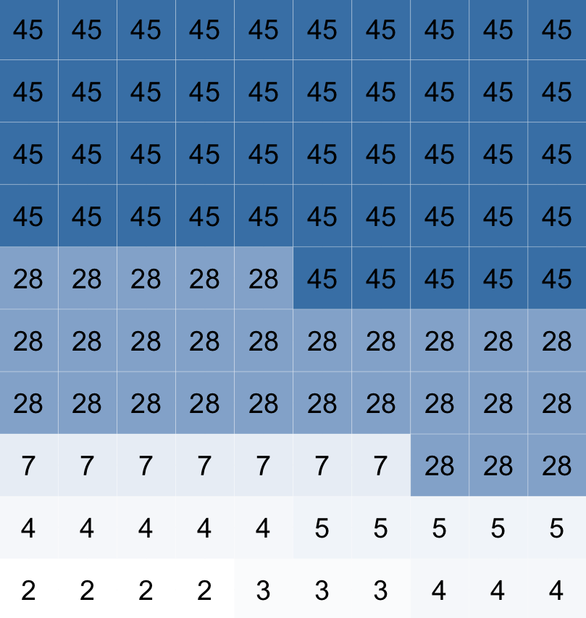
Classes as Sampling Units
Students as Sampling Units
Each box is a class
Number is class size
Average Class Size
11
Each box is a student
Number is classmates (including focal student)
Average Classmates
29

Slide 2
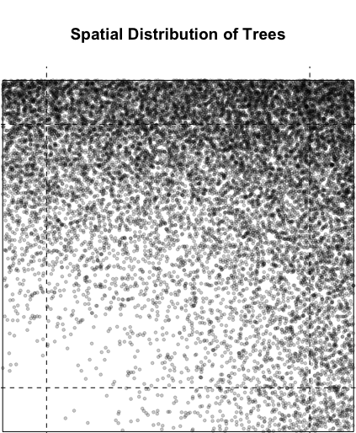
This is a simulation of the spatial distribution of trees
We want to understand the characteristics of trees in space.
How do we sample?
We could sample locations or trees as our sample units.

Slide 3
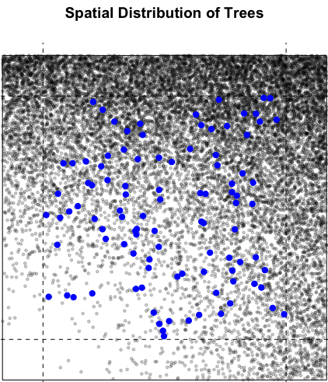
This is a simulation of the spatial distribution of trees
We want to understand the characteristics of trees in space.
How do we sample?
We could sample locations or trees as our sample units.
Blue points represent a random sample of locations

Slide 4
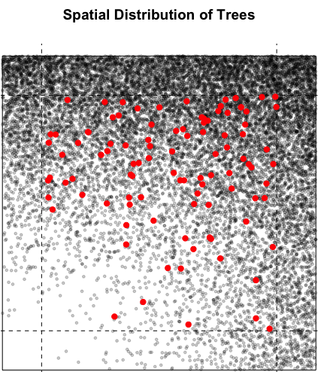
This is a simulation of the spatial distribution of trees
We want to understand the characteristics of trees in space.
How do we sample?
We could sample locations or trees as our sample units.
Blue points represent a random sample of locations
Red points represent a random sample of trees

Slide 5
Are they the same?

Slide 6
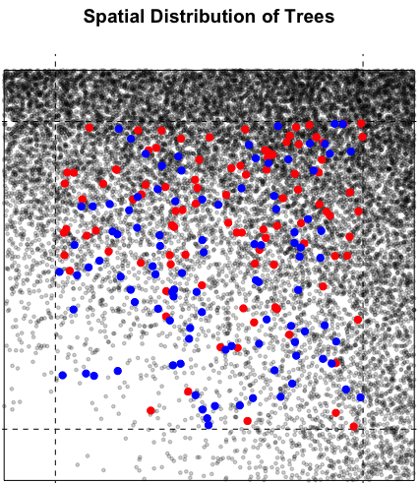
These samples are not the same.
They differ based on how random they are with respect to spatial attributes.
The spatial sample randomly chooses locations. If your question is about the properties of space, use this sample.
The tree sample randomly chooses trees. If your question is about the experience of trees, choose this sample.
This distinction is important because your answers differ. Consider the property of how much trees clump together.

Slide 7
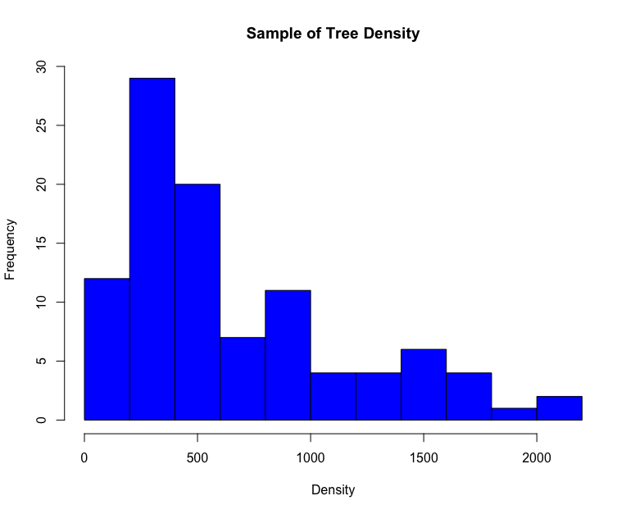
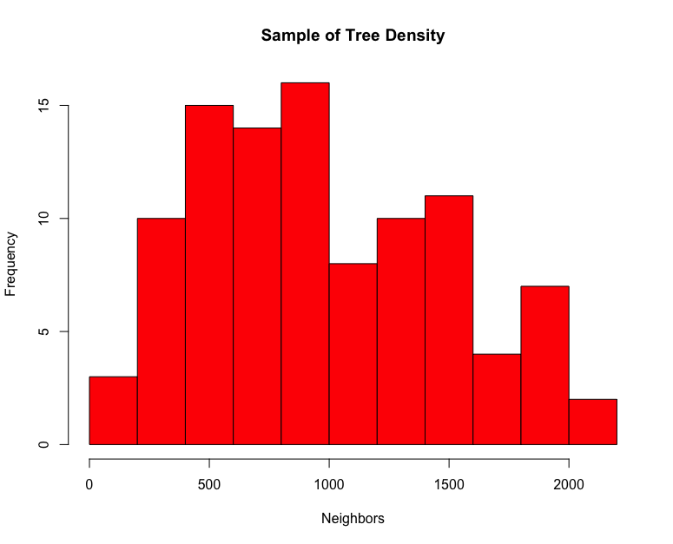
How many trees near a sample point?
How many trees near each sampled tree?
Average = 665 trees
Average = 980 trees

